Slide 1
Lehua Hawaiian Adventures
Carl Kawaoka
Tour Manager

Slide 2
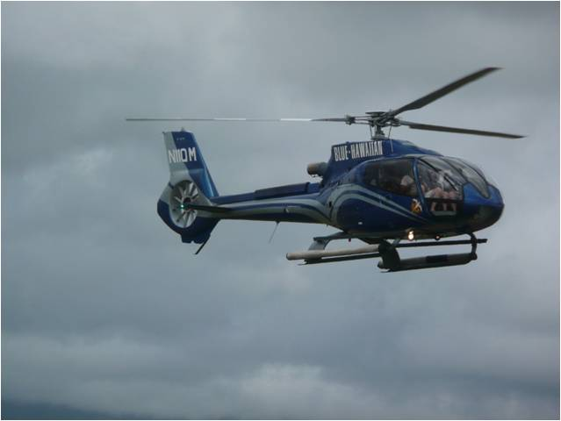
Do You Enjoy Adventure?
Hiking and cycling
Explore amazing locations
Boating excursions
Exhilarate your senses while at sea
Helicopter tours
View Hawaii from above

Slide 3
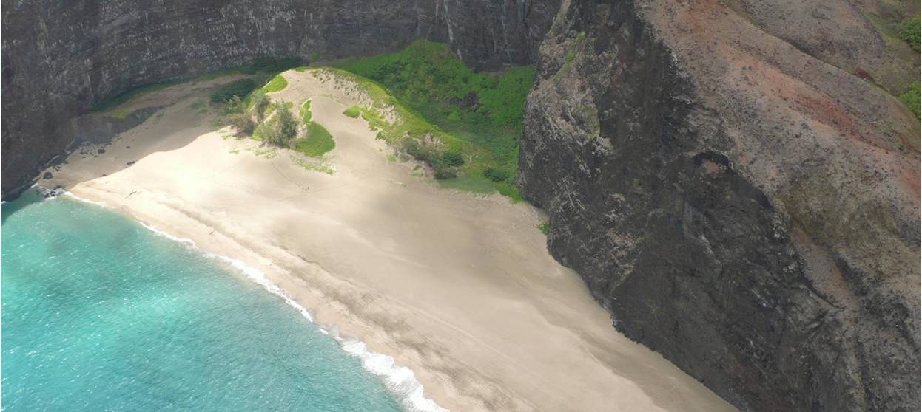
Prepare to be Amazed
Mountain, sea, volcano. Our tour guides are experts in the history, geography, culture, and flora and fauna of Hawaii.

Slide 4
About Our Company
Named for the crescent-shaped island noted for scuba diving, Lehua Hawaiian Adventures offers exciting and affordable tours throughout Hawaii
Notes:
Lehua Hawaiian Adventures is based in Honolulu, but has offices on each of the main Hawaiian islands.

